Slide 1


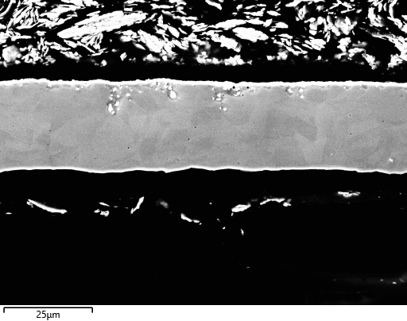





Phase 2 – Initial Carbon Coating
And also some EBSD:

Slide 2
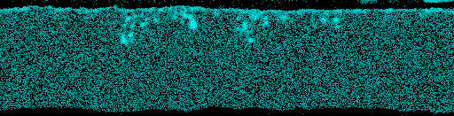
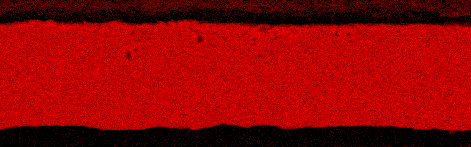
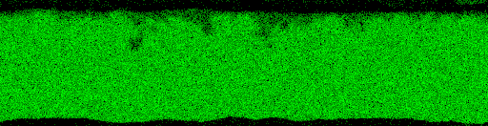

Phase 2 – Initial Carbon Coating
And also some EBSD:
Pb
Fe
Cr
Ni

